Slide 1

HOUSING_PRICE PREDICTION
Submitted by:
ARUN KUMAR M

Slide 2
Business Problem Framing :
We are required to model the price of houses with the available independent variables. This model will then be used by the management to understand how exactly the prices vary with the variables. They can accordingly manipulate the strategy of the firm and concentrate on areas that will yield high returns. Further, the model will be a good way for the management to understand the pricing dynamics of a new market.

Slide 3
Mathematical/ Analytical Modelling of the Problem :
-This is a Linear Regression Problem.
-Mean, Median and Mode of each continuous column was calculated to get an overview of the data.
-Data’s which didn’t provide any feature importance are removed from the data-set.
-Skewed columns are treated with Log Transform.
-General statistical data is obtained to perform imputation and visualization.
-The data is divided into categorical and numerical variables during the analysis.

Slide 4
Data Sources and their formats :
-The Data-set seems to be divided into 2 sets, one for training and one for testing.
-The train data-set seems to have 1168 rows and 81 columns.
-The test data-set seems to have 292 rows and 80 columns.
Both the files were given as csv files.
-The data-set contains 3- float data types, 35-int data types and 43-object data types.

Slide 5
Data Preprocessing Done :
-The columns which didn’t give any feature importance have been dropped.
-The Null values are found and visualized using missing package as follows.

Slide 6
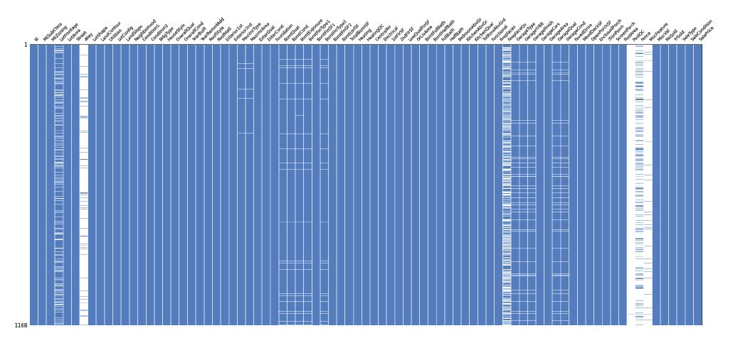

Slide 7
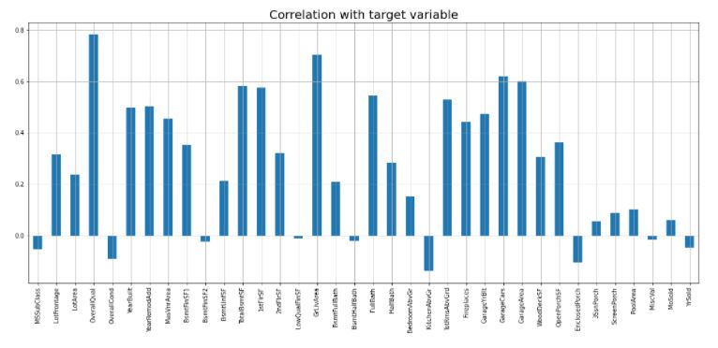

Slide 8
DATA VISUALIZATION

Slide 9
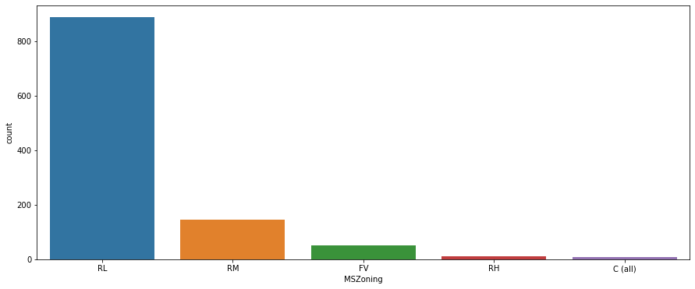

Slide 10
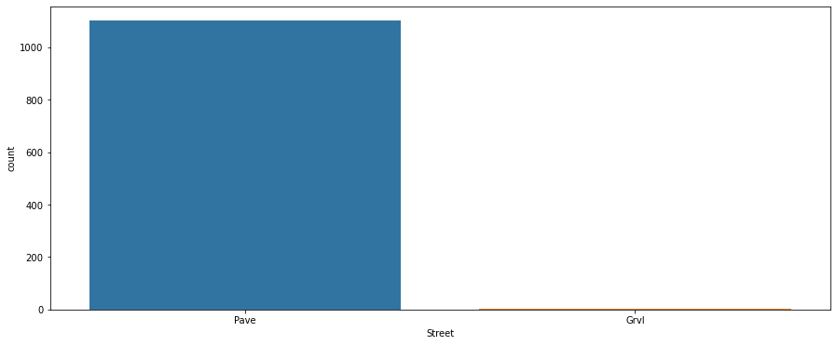

Slide 11
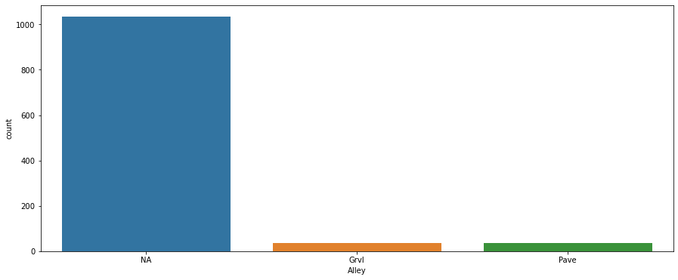

Slide 12
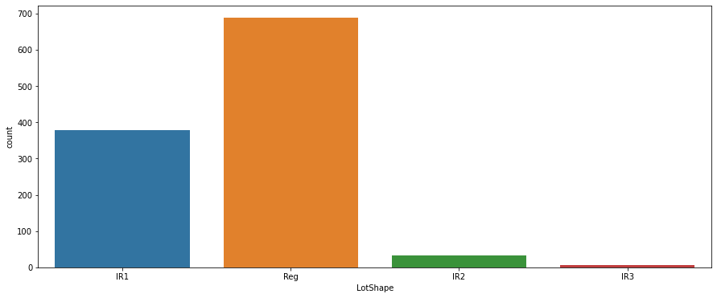

Slide 13
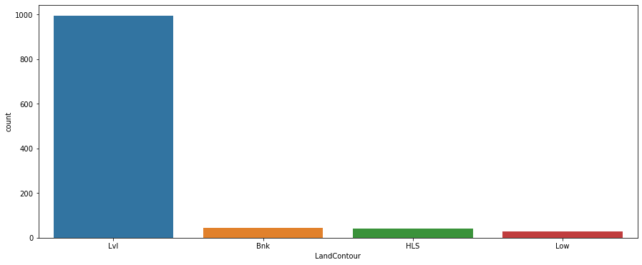

Slide 14
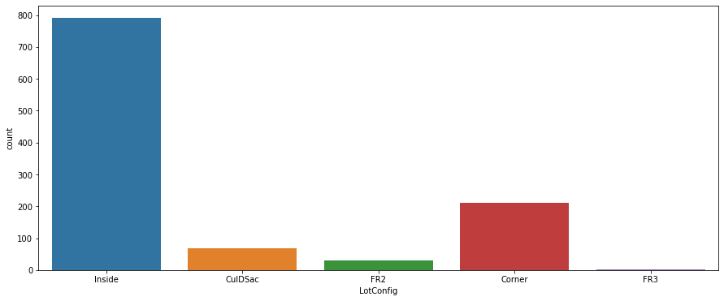

Slide 15
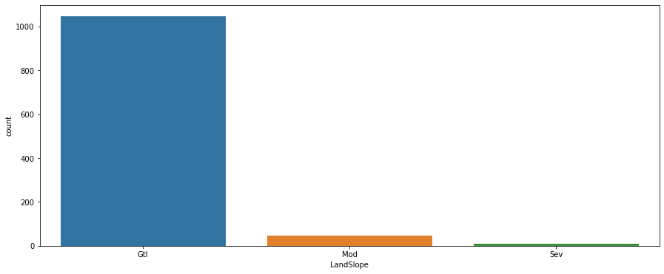

Slide 16
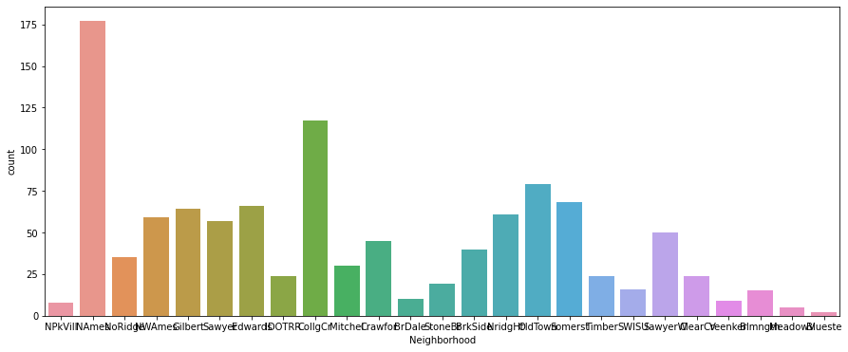

Slide 17
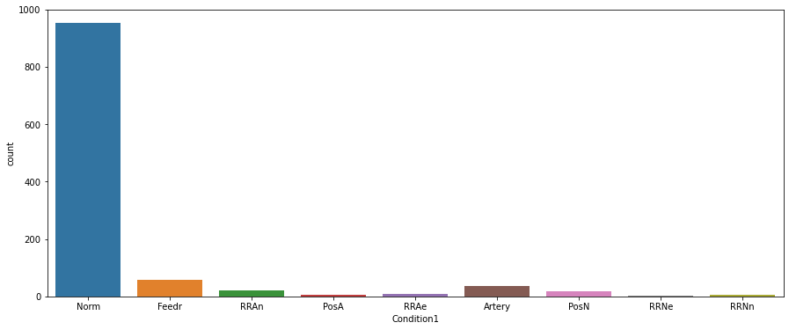

Slide 18
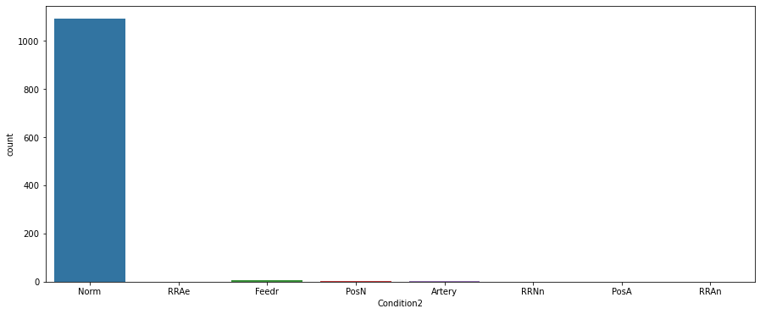

Slide 19
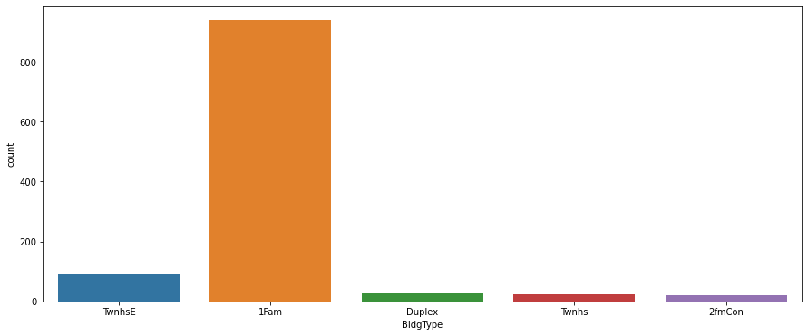

Slide 20
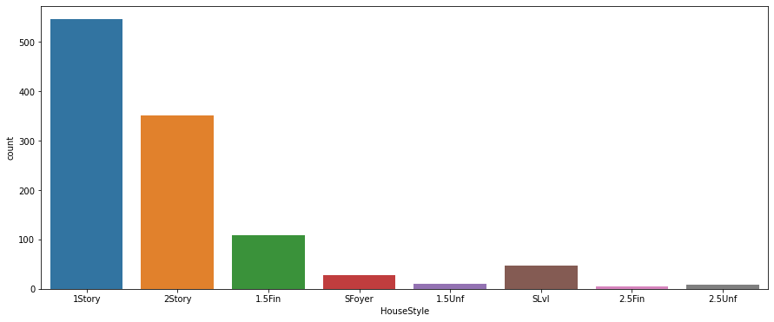

Slide 21
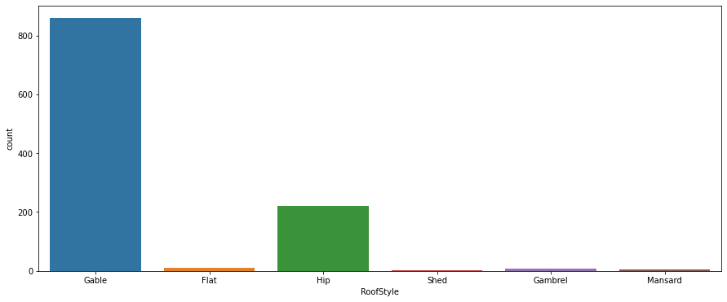

Slide 22
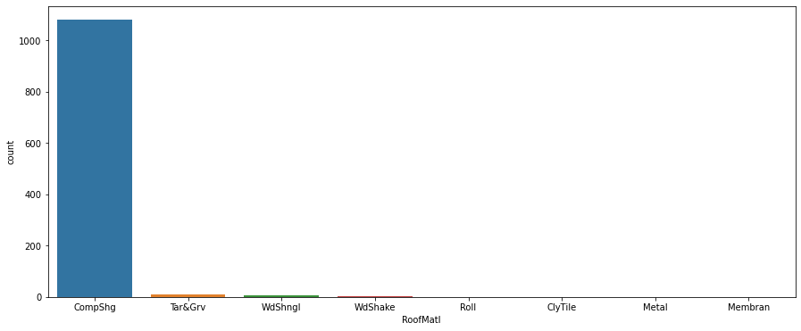

Slide 23
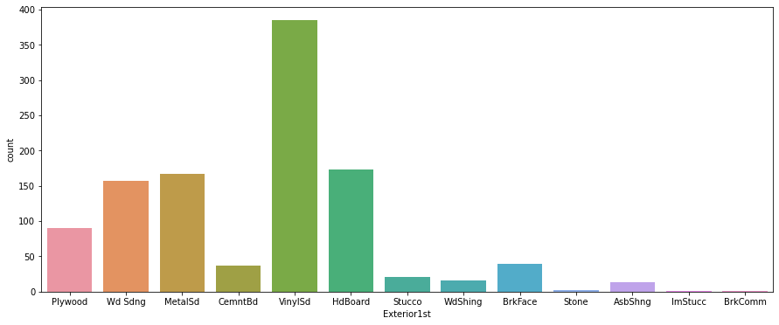

Slide 24
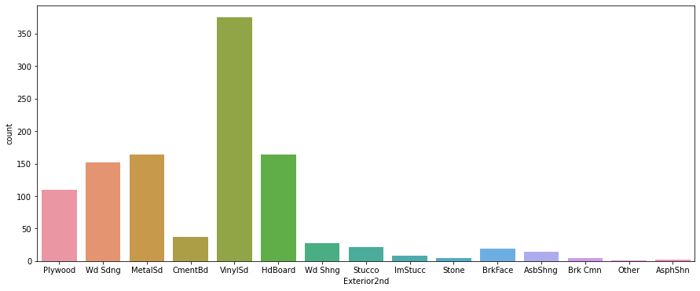

Slide 25
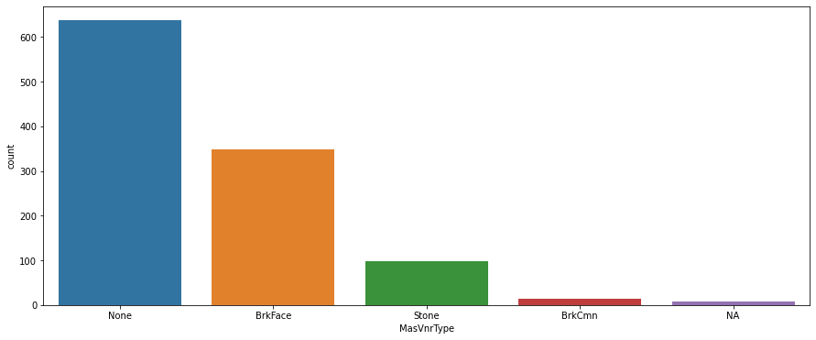

Slide 26
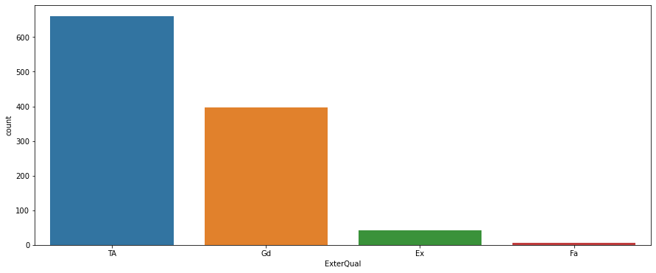

Slide 27
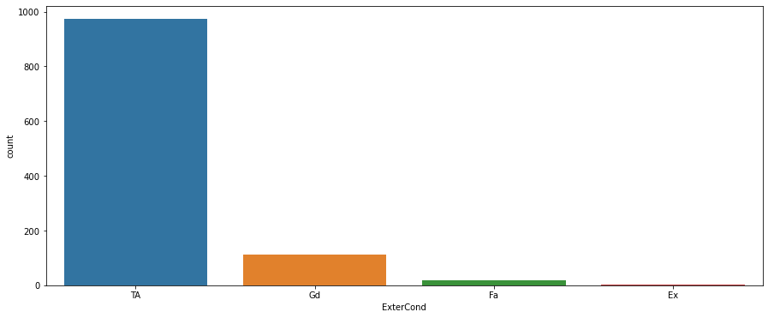

Slide 28
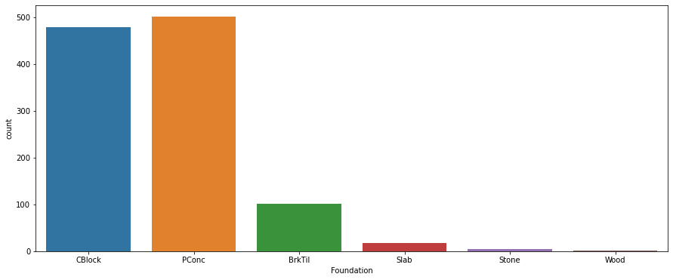

Slide 29
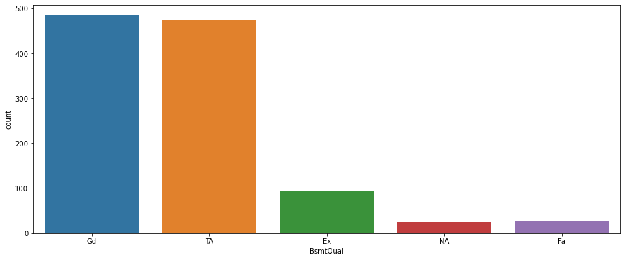

Slide 30
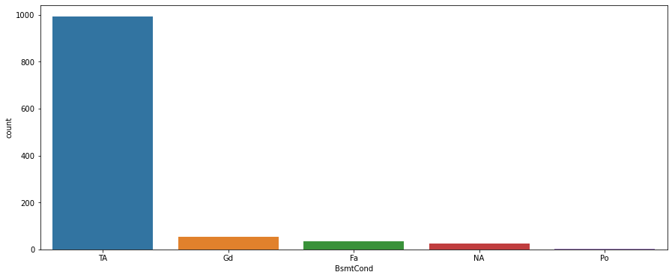

Slide 31
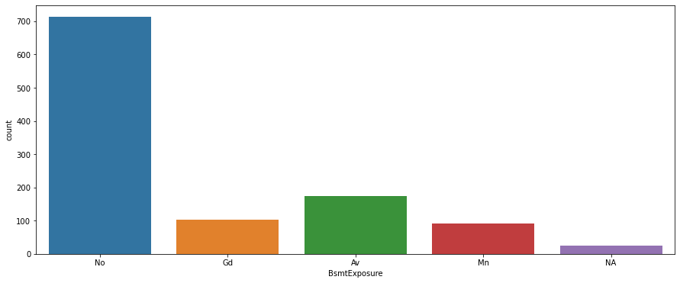

Slide 32
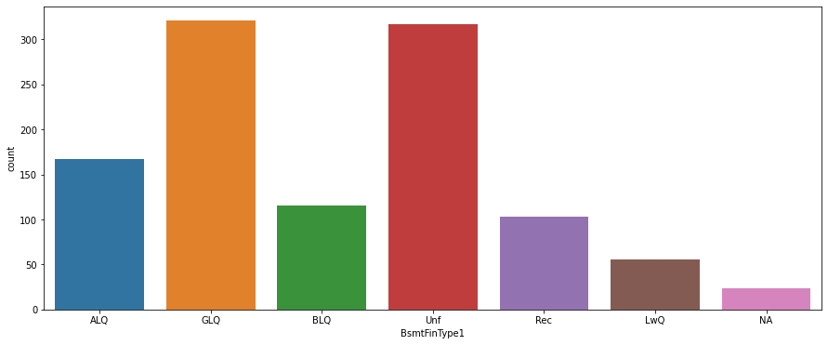

Slide 33
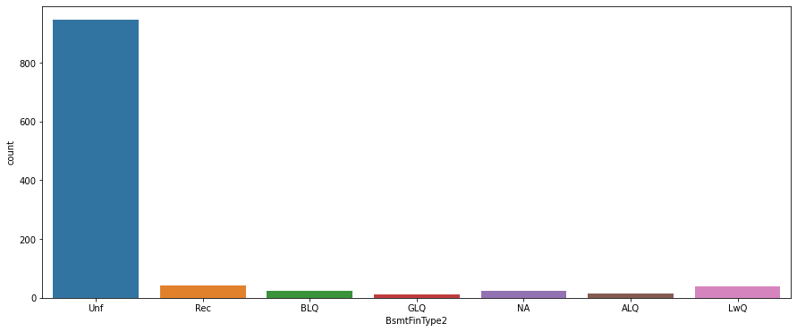

Slide 34
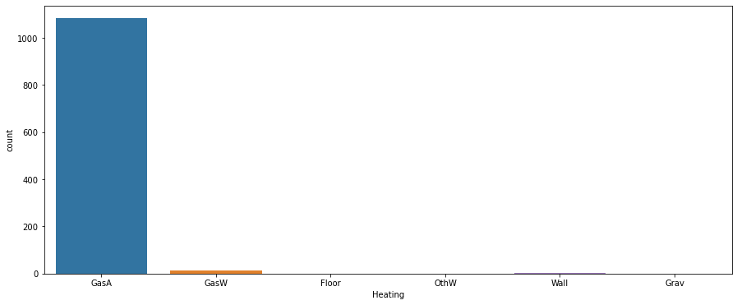

Slide 35
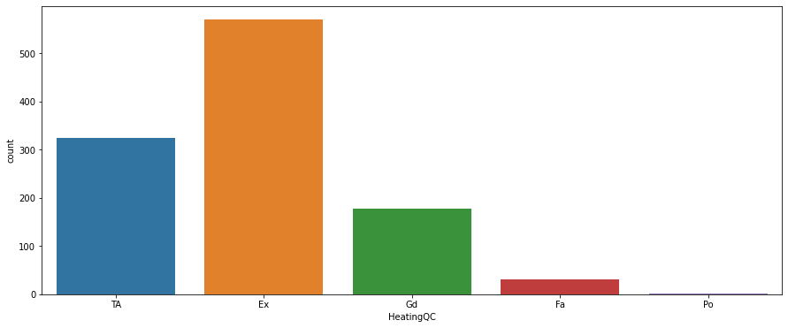

Slide 36
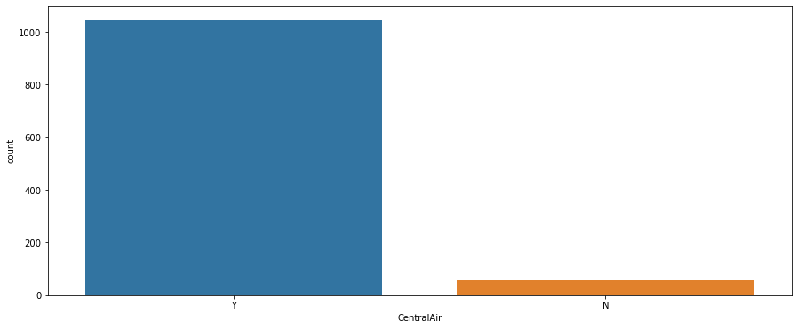

Slide 37
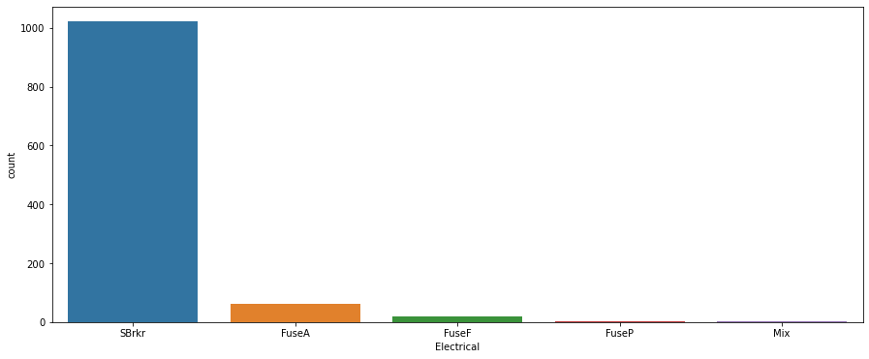

Slide 38
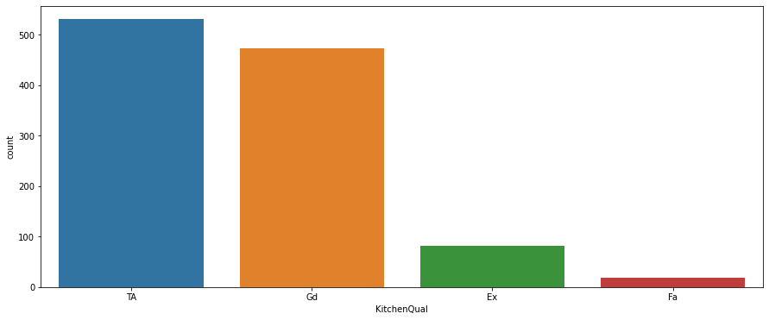

Slide 39
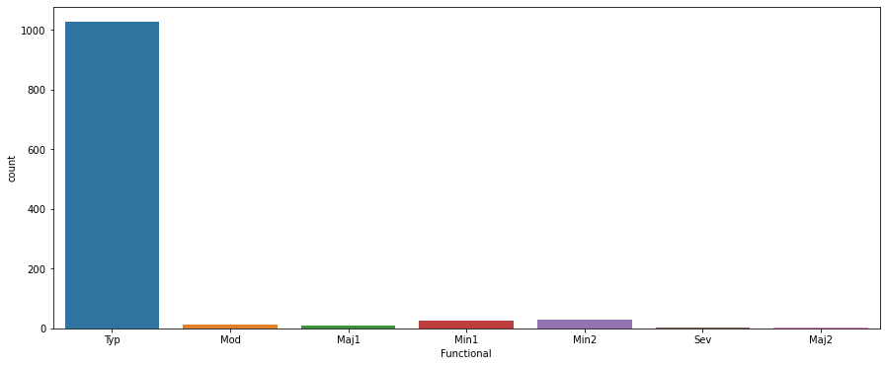

Slide 40
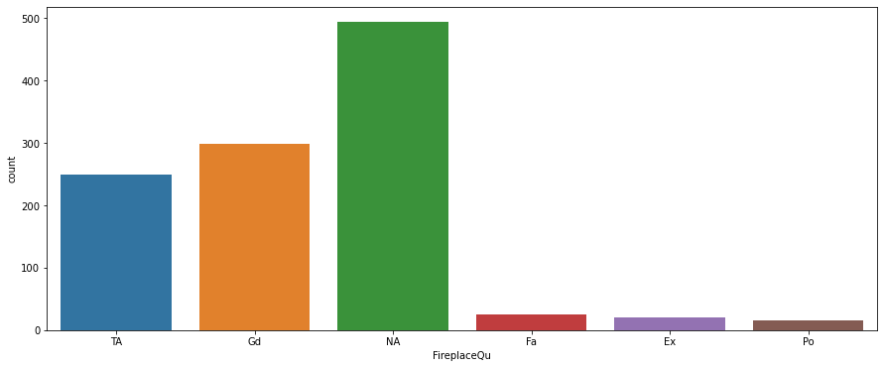

Slide 41
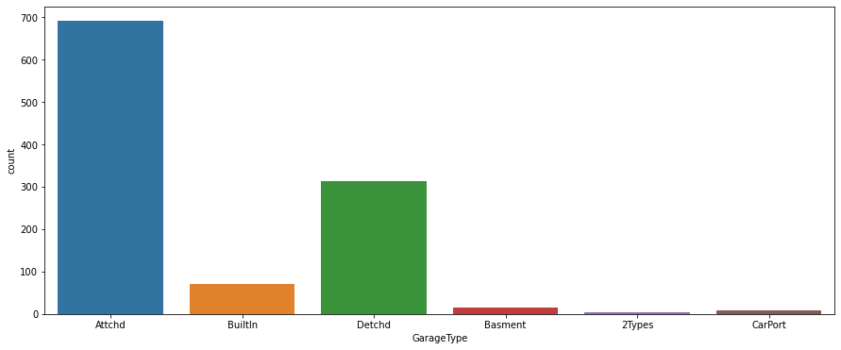

Slide 42
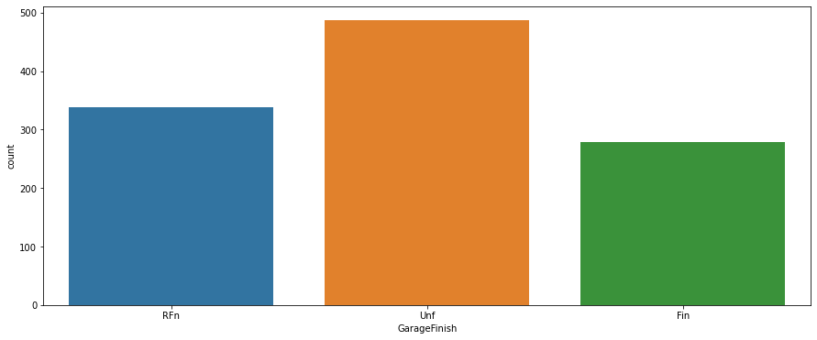

Slide 43
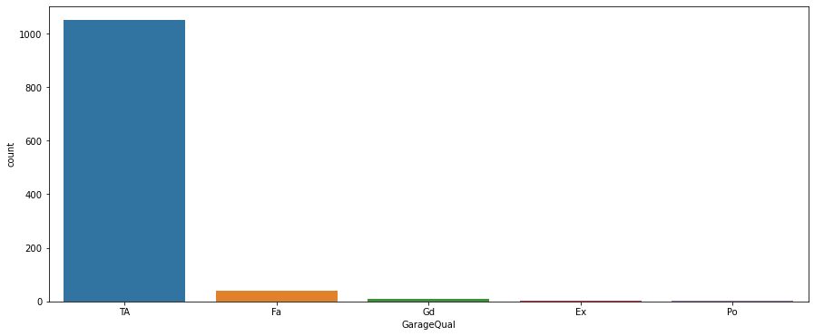

Slide 45
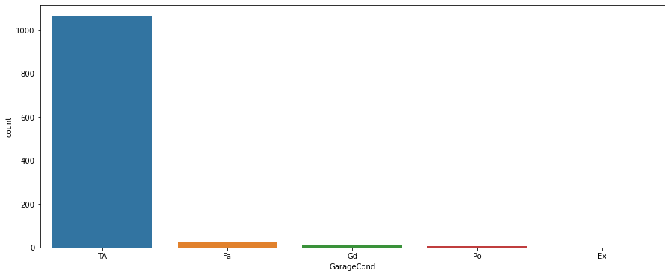

Slide 46


Slide 47
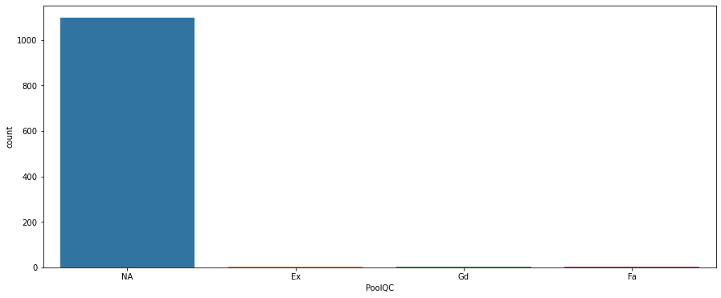

Slide 48
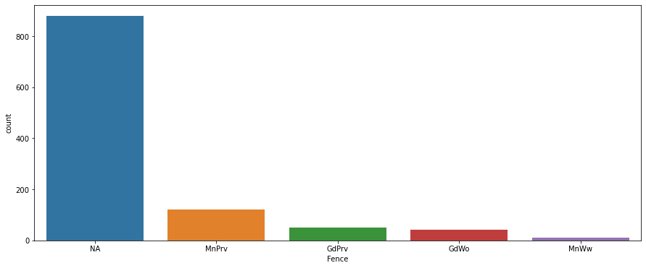

Slide 49


Slide 50
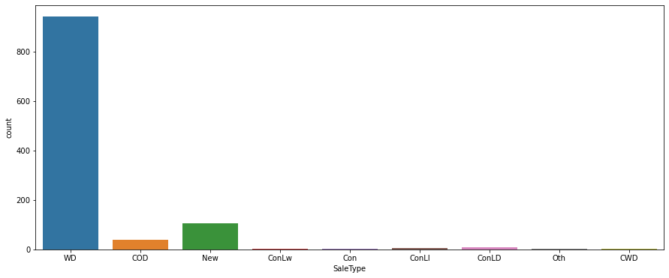

Slide 51
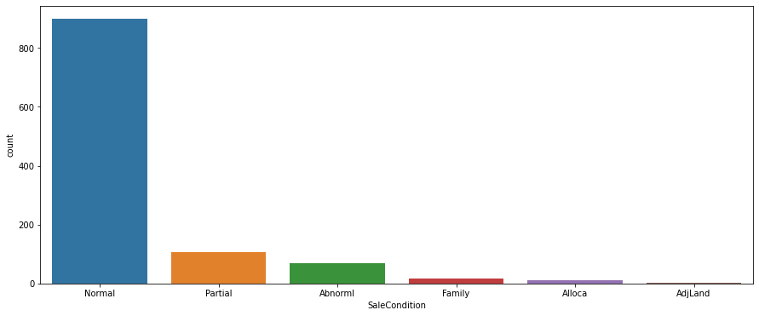

Slide 52
Observation on UNI-VARIATE ANALYSIS :
1.On considering the Zone of the house located we could infer that the Residential Low Density zones have higher sales.
2.90% of the houses have paved road access.
3.Many houses doesnt have an Alley access.
4.Most of the plot shapes of the houses are Regular and Slightly irregular. Only a handful of the property have a irregular lot shape.
5.Around 90% of the lot has a Flat Landcontour.
6.Also most of the Lot configuration are Inside Lot.
7.The slope of most property are Gentle.
8.The NWAmes and college creek are the most common neighborhood.
9.Most houses have the proximity to various conditions as normal.
10.Single family detached is the most common form of house found in the data-set.

Slide 53
11.One story, Two story are known to be the common house style followed by One and one-half story: 2nd level finished.
12.Gable is found to be the roof style for most of the houses followed by Hip.
13.Standard (Composite) Shingle is the most common material used for roofing.
14.Exterior condition of the most houses are Average / Typical.
15.Cinder Block and Poured Contrete are the common type of foundation used followed by Brick & Tile.
16.The height of the basement for most houses are found to be Good and Typical.
17.Also most basements seems to have slight dampness.
18.Most of the basement have no exposure.
19.More than 95% of the houses have Gas forced warm air furnace Type of heating.
20.Most heating equipments in the houses are found to be excellent to average.
21.90% of houses have Central air conditioning.

Slide 54
22.Standard Circuit Breakers & Romex is found to be the most common Electrical system.
23.Most houses have excellent kitchen condition.
24.Most houses have Typical Home functionality.
25.Most of the houses dont have a fire place.
26.Many houses have a attached garage.
27.Also many garages seems to be unfinished.
28.Garage quality of most houses seems to be typical.
29.Paved driveway is the most commn drive way.
30.Almost 95% of the houses dont have a Pool.
31.Many houses dont have a Fence.
32.Many dont have any of the following features Elevator,2nd Garage,Other,Shed,Tennis Court.
33.Most of the houses are sold by Warranty Deed - Conventional, followed by new homes and Court Officer Deed.
34.Most of the houses are sold under Normal condition. but some of them are sold in partial construction and abnormal conditions such as trade, foreclosure, short sale.

Slide 55
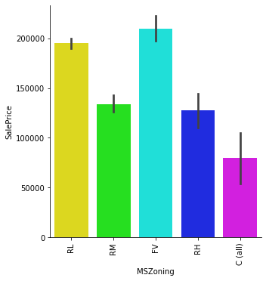

Slide 56
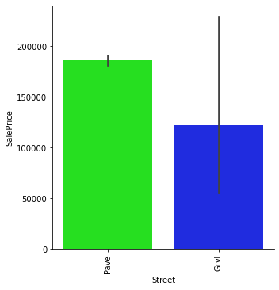

Slide 57
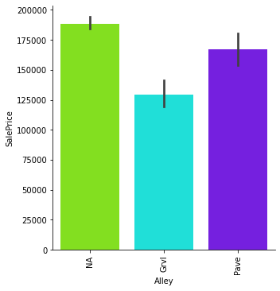

Slide 58
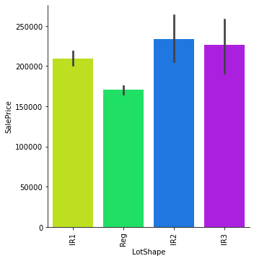

Slide 59
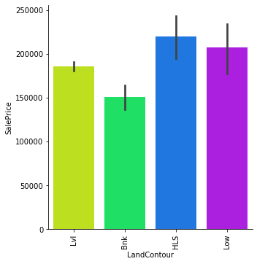

Slide 60
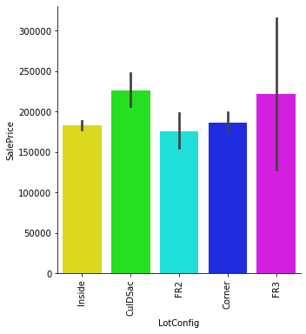

Slide 61
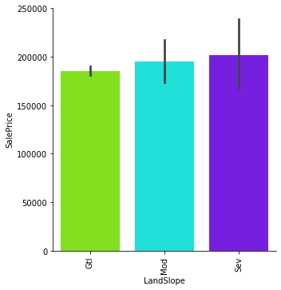

Slide 62
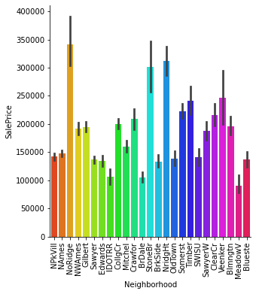

Slide 63


Slide 64


Slide 65


Slide 66


Slide 67


Slide 68


Slide 69


Slide 70


Slide 71


Slide 72


Slide 73


Slide 74


Slide 75


Slide 76


Slide 77


Slide 78


Slide 79


Slide 80


Slide 81


Slide 82


Slide 83


Slide 84


Slide 85


Slide 86


Slide 87


Slide 88


Slide 89


Slide 90


Slide 91


Slide 92


Slide 93


Slide 94


Slide 95


Slide 96


Slide 97


Slide 98


Slide 99


Slide 100


Slide 101


Slide 102


Slide 103


Slide 104


Slide 105


Slide 106


Slide 107


Slide 108


Slide 109


Slide 110


Slide 111


Slide 112


Slide 113


Slide 114


Slide 115


Slide 116


Slide 117


Slide 118


Slide 119


Slide 120


Slide 121


Slide 122


Slide 123


Slide 124


Slide 125


Slide 126


Slide 127


Slide 128


Slide 129


Slide 130


Slide 131


Slide 132


Slide 133
Observation on BI-VARIATE ANALYSIS :
1.2-STORY 1946 & NEWER, 2-STORY 1945 & OLDER is known to be the popular houses selling at higher price followed by 1-STORY
PUD (Planned Unit Development) - 1946 & NEWER.
2.Lots between 150-200 linear feet seems to have higher sales price.
3.Price of the houses increses with the overall material and finish of the house.
4.Houses built between 1880-1900 and 1980-2006 seems to have higher sales price.
5.Houses with garage of 3 car capacity seems to have higher sales price and are selling more in numbers.
6.Most expected garage area is 600-900 sqft.
7.Houses with openporch sells quickly.
8.Also enclosed Porch seems to have higher sales price.

Slide 134
Feature Engineering:
-During feature engineering the categorical datas are turned into numerical values using Label Encoding.
-While implementing the z-score we found that the data loss is more than 60%. So we continued the data processing without implementing z-score.

Slide 135
Machine Learning Models:
For the above data-set we will use
1.LINEAR REGRESSION
2.RANDOM FOREST REGRESSOR
3.SGD REGRESSOR
4.LASSO
5.RIDGE
6.DecisionTreeRegressor
7.KNeighborsRegressor
8.AdaBoostRegressor
9.GradientBoostingRegressor

Slide 136


Slide 137


Slide 138


Slide 139


Slide 140


Slide 141


Slide 142


Slide 143


Slide 144


Slide 145
From the above results we could clearly see that the “RIDGE REGRESSOR” is having a good r2 Score and Cross-validation score.
So, We will Choose Ridge Regressor as our final Model.

Slide 146
HYPER PARAMETER TUNING - Ridge

Slide 147



Slide 148

We could see that the scatter is a straight line which implies that the model is working properly.

Slide 149


Slide 150
PREDICTION ON THE TEST DATA-SET

Slide 151

we will now do all the Data pre-processing done for the Training dataset, on the Test Data-set.

Slide 152


Slide 153
CONCLUSION REMARKS:
1. we could see that using "RIDGE regression" gives a most promising predictions when compared with all other MOdels.
2. Also many Factors influence the sale of a House, but year built, plot area, garage type, road access, availability of some basic features seems to have a higher hand in deciding the sales price for a house.

Slide 154
END

